Slide 1
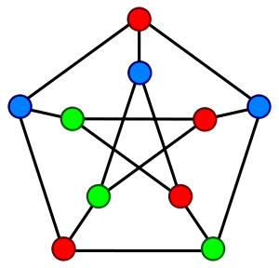
Workshop on Graph Theory
academy.zariba.com

Slide 2
Workshop Contents
What are graphs?
Are they useful?
Implementing our own Generic Graph
Depth First Search
Hacking the “Wordz” game
Optional exercises

Slide 3
1. What are graphs?
A graph is roughly said a collection of vertices (points) and edges (lines) between them.
Edges can be directed, undirected, coloured, weighted etc.

Slide 4
2. Are they useful?
Well… yes. They have some really interesting applications
Pathfinding (GPS systems)
Matchings
Algorithms
NoSQL databases
Many more

Slide 5
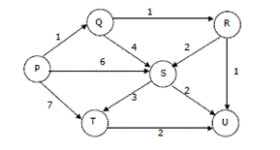
2. Are they useful?

Slide 6
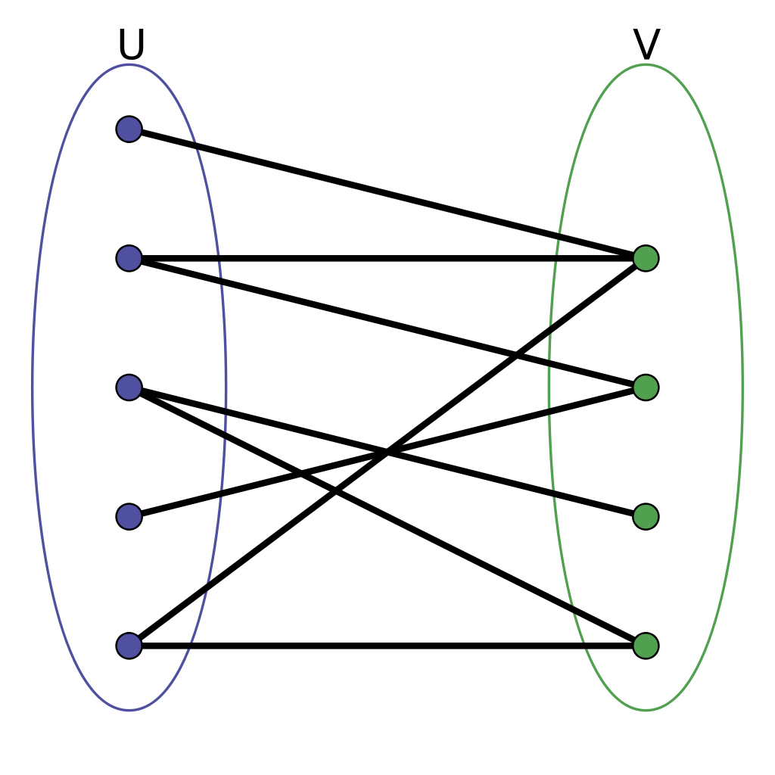
2. Are they useful?

Slide 7
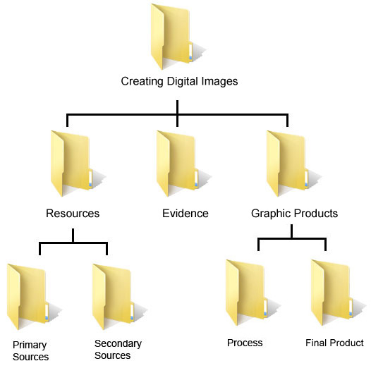
2. Are they useful?

Slide 8
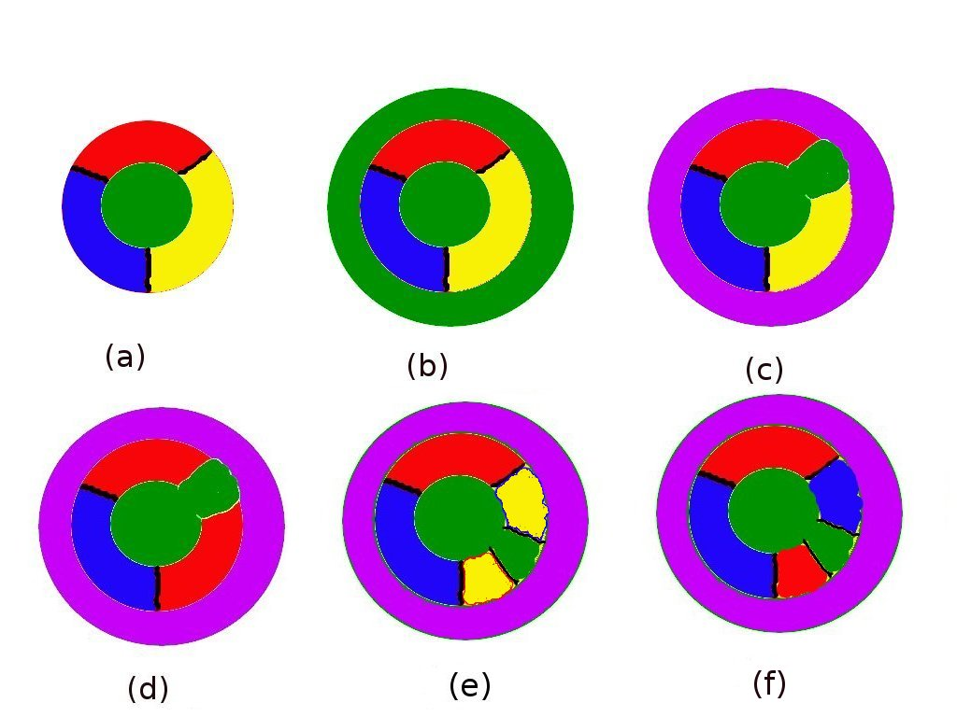
2. Are they useful?

Slide 9
3. Implementing our own Generic Graph
We will be revising and extending our knowledge on:
Generic classes
Quality Code
Inheritance
Abstraction
Encapsulation
Cohesion
Coupling
Algorithms

Slide 10
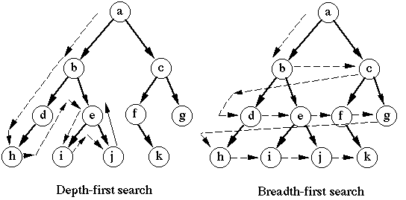

4. Depth-First-Search

Slide 11
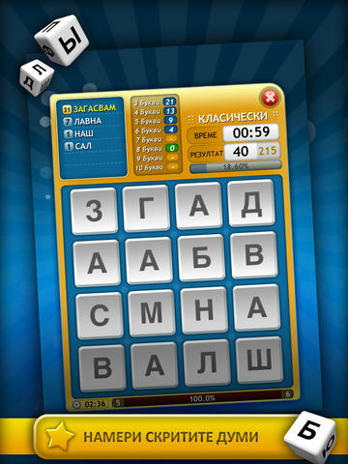
5. Hacking the “Wordz” game

Slide 12
6. Optional Homework
Implement the Breadth-First-Search algorithm.
Read online and implement Dijkstra’s algorithm.
Create a Cycle class on n vertices which inherits from Graph.
Create a Path class on n vertices which inherits from Graph.

Slide 13
Abstraction
Abstraction means ignoring irrelevant features, properties, or functions and emphasizing on the ones relevant to the specific project
Abstraction helps managing complexity
Abstraction in .Net can be done with the use of abstract classes or interfaces (or both)

Slide 14
Interfaces
Interfaces define a set of operations and attributes
They do not provide any implementation – only a contract for implementing the defined features of a class
Can be extended by other interfaces
Cannot be instantiated

Slide 15
Abstract Classes
Abstract classes are a mix between an interface and a class
Partially or fully provide implementation
Non implemented methods are declared as abstract and are left empty (same as interfaces)
Cannot be instantiated
Child classes, which are not abstract, should implement all abstract methods

Slide 16

4. Encapsulation
Fields are always declared private
Constructors are almost always public
Interface methods are always public
Non-interface methods are declared private or
protected
Hides implementation details and reduces
complexity

Slide 17
Homework
1. We are given a school. In the school there are classes of students. Each class has a set of teachers. Each teacher teaches a set of disciplines. Students have a name and a unique class number. Classes have unique text identifier. Teachers have a name. Disciplines have a name, number of lectures and number of exercises. Both teachers and students are people. Students, classes, teachers and disciplines could have optional comments (free text block). Your task is to identify the OOP classes, their attributes and operations, encapsulate their fields , define the class hierarchy and create a class diagram.

Slide 18
Homework
2. Define an abstract class Human with a first name and last name. Define a new class Student which is derived from Human and a has a new field – grade. Define class worker derived from Human with a new property WeekSalary and WorkHoursPerDay and a method MoneyPerHour() which returns the money earned per hour. Define the constructors and properties for this hierarchy. Initialize a list of 10 students and sort them by grade in ascending order (Linq?). Initialize a list of 10 workers and sort them by money per hour in descending order. Merge the lists and sort them by first name and last name

Slide 19

References

Slide 20



Zariba Academy
Questions

